Slide 1
MOBILE DATABASES
Unit 5

Slide 2
Contents
Design Issues,
Problems in mobile databases,
CODA file system – case study

Slide 3
Introduction
Mobile databases in mobile computing are specialized data management systems designed to store, process, and synchronize data on mobile devices.
They address unique challenges like limited device resources, intermittent network connectivity, and data distribution across multiple locations.
These databases support efficient querying, offline operations, secure data handling, and seamless synchronization between mobile devices and central servers while optimizing power consumption and storage usage.

Slide 4
Need of Mobile Databases
Mobile users need the ability to handle transactions on their devices - basically, they want to perform secure operations like making payments or updating records directly from their mobile devices.
People want to perform everyday tasks like sending money, booking seats, or trading stocks right from their mobile devices without having to visit physical locations.
Users expect constant access to their information - no matter where they are, what time it is, or whether they're moving around or staying in one place. This "anytime, anywhere" access is essential.

Slide 5
Uses of Mobile Databases
Mobile databases let developers create and deploy database applications specifically for handheld devices, making it possible for mobile users to work with data-driven apps on their portable devices.
Employees with mobile devices can use these databases to:
Connect to their company's network
Download needed data to work offline
Sync their work back to the main company database when connected
Real-world example: A food delivery app rider using their mobile device to:
Accept new food orders while on the move
Track delivery locations and customer details offline
Update delivery status in real-time when food is delivered
Automatically sync all completed deliveries to the restaurant's main system

Slide 6
Mobile Databases: Design Issues
Mobile Computing Foundation: The entire concept of mobile computing directly influences how mobile databases are designed and implemented. This means every aspect must be built specifically for mobile use rather than just adapting traditional database systems.
Query Optimization Challenge: When users are constantly moving, managing data requests becomes complex. The cost of communication changes as users move between different network areas, making it difficult to determine the best way and location to deliver query results.

Slide 7
Cont..
Time Management: In today's business applications, user time is extremely valuable. Both connection time and data transfer amount are often charged by mobile carriers, so database systems must retrieve and deliver information quickly and efficiently to keep costs down.
Power Efficiency: Since mobile devices operate on limited battery power, energy consumption must be carefully controlled. This means all database operations, especially query processing, need to be completed quickly while using minimal power to extend battery life.

Slide 8
Problems in Mobile Databases
Routing: One of the major costs involved in wireless communication is based on connection time.
Query Processing: Mobile hosts might experience substantial disconnection periods. During these disconnections, users may continue working and issue queries or updates on locally cached data.
Recoverability: Updates entered on a disconnected mobile host may be permanently lost if the machine fails.
Consistency: Locally cached data can become inconsistent, but the mobile host can only discover this inconsistency after reconnection. No updates can be propagated until the device reconnects.

Slide 9
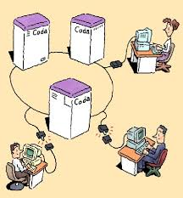
CODA File System
CASE STUDY

Slide 10
Coda file system
The Coda file system was developed to support disconnected operations, allowing users to work offline.
First demonstrated at Carnegie Mellon University, it enables clients to access critical data during temporary failures of shared repositories like SUN- NFS, and AFS.
While mobile users typically need continuous connections to access remote resources, Coda addresses this challenge by implementing data caching techniques to enhance availability.

Slide 11
Coda file system
The Coda file system environment consists of numerous untrusted UNIX clients and fewer trusted Unix file servers.
Each Coda client features a local disk with 100 MB cache capacity and connects to servers via high-bandwidth network connections.
Coda provides a location-transparent shared UNIX file system where the namespace is organized into sub-trees called volumes, which map to individual file servers.
At each client, a cache manager called Venus dynamically obtains and maintains volume mappings.

Slide 12
Coda file system Mechanisms: Server replication
Server replication allows volumes to have read-write replicas on multiple servers (Volume Storage Group or VSG).
Clients maintain awareness of accessible servers through an Accessible Volume Storage Group (AVSG).
Venus (cache manager) uses a coherence protocol to ensure clients access the latest file versions.
Servers notify clients when cached copies become invalid.
Modifications propagate in parallel to all AVSG sites and eventually reach missing VSG sites.

Slide 13
Coda file system Mechanisms: Disconnected operation
During disconnected operation, Venus services file system requests using only the contents of the local cache.
When disconnection ends, Venus propagates all modifications to servers and returns to server replication mode.

Slide 14
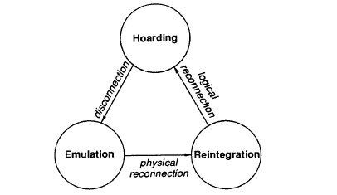
Coda File System: Venus States
The system transitions between three states: Hoarding (preparation), Emulation (disconnected operation), and Reintegration (reconnection).

Slide 15
Hoarding
Venus proactively stores data before disconnection occurs.
Venus prefetches files while still connected to the server.
When strongly connected to servers, Venus prioritizes prefetching files that are actively being used.
Venus manages cache content using the Least Recently Used (LRU) strategy to determine which files to keep.

Slide 16
Emulation
When a client disconnects, applications work with local replicas in Emulation mode.
During Emulation, Venus functions as a pseudo-server, handling access control and semantic checks.
Venus generates temporary file IDs for newly created objects.
The system allows both reading and writing to all cached files.
Venus maintains a record of all changed files during disconnection.
After reconnection, Coda compares local replicas with server versions.
If Coda detects conflicting changes from different users, reintegration fails and the system saves the changed file as a copy on the server for manual integration.

Slide 17
Reintegration
During Reintegration, Venus transitions from acting as a pseudo-server back to functioning as a cache manager.
Venus propagates all changes made during the Emulation (disconnected) phase to the server.
The system updates its local cache to reflect the current server state.
Reintegration occurs after physical reconnection to the server network.

Slide 18
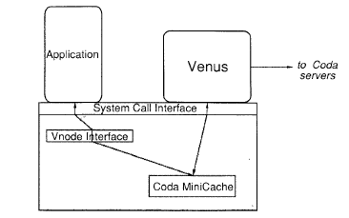
Client structure in CODA

Slide 19
Client structure in CODA
Venus operates at the user level rather than kernel level for greater flexibility.
CODA employs a small in-kernel mini cache that filters many Venus-kernel interactions, improving efficiency.
When an application makes system calls for CODA objects, requests first go to the mini cache through the Vnode interface.
If the mini cache cannot service the request, it calls Venus, which contacts remote servers as needed.
After processing, control returns to the application program from Venus via the mini cache.
Venus regularly updates the mini cache state to maintain consistency.

Slide 20
CODA File System Design Rationale
Built to work with standard commercial hardware rather than specialized equipment
Maintains transparency so users don't need to know file locations
Created with scalability in mind to accommodate growing networks
Designed for portable workstations to support mobile computing needs
Focuses on high availability to ensure access even during network disruptions
Emphasizes consistency to maintain data integrity across distributed systems

Slide 21
END

